Slide 1

Data Communication and Networking (DCAN 202)
Kent Institute Australia Pty. Ltd.
ABN 49 003 577 302 CRICOS Code: 00161E RTO Code: 90458 TEQSA Provider Number: PRV12051
Version 2 – 18th December 2015

Slide 2

Chapter 4: Making Connections
Data Communications and Computer Networks: A Business User's Approach, Eighth Edition
© 2016. Cengage Learning. All right reserved.

Slide 3
Todays Lecture
Recognize the difference between half-duplex and full-duplex connections
Identify the operating characteristics of terminal-to-mainframe connections and why they are unique compared to other types of computer connections

Slide 4
Introduction
Connecting peripheral devices to a computer has, in the past, been a fairly challenging task
Newer interfaces have made this task much easier
Let’s examine the interface between a computer and a device
This interface occurs primarily at the physical layer

Slide 5
Interfacing a Computer to Peripheral Devices
The connection to a peripheral is often called the interface
The process of providing all the proper interconnections between a computer and a peripheral is called interfacing

Slide 6
Characteristics of Interface Standards
There are essentially two types of standards
Official standards
Created by standards-making organizations such as ITU (International Telecommunications Union), IEEE (Institute for Electrical and Electronics Engineers), (now defunct) EIA (Electronic Industries Association), ISO (International Organization for Standardization), and ANSI (American National Standards Institute)
De facto standards
Created by other groups that are not official standards but because of their widespread use, become “almost” standards

Slide 7
Characteristics of Interface Standards (continued)
There are four possible components to an interface standard:
Electrical component: deals with voltages, line capacitance, and other electrical characteristics
Mechanical component: deals with items such as the connector or plug description
Functional component: describes the function of each pin or circuit that is used in a particular interface
Procedural component: describes how the particular circuits are used to perform an operation

Slide 8
Two Important Interface Standards
In order to better understand the four components of an interface, let’s examine two interface standards
EIA-232F – an older standard originally designed to connect a modem to a computer
USB (Universal Serial Bus) – a newer standard that is much more powerful than EIA-232F

Slide 9
An Early Standard: EIA-232F
Originally named RS-232 but has gone through many revisions
All four components are defined in the EIA-232F standard:
Electrical
Mechanical (DB-25 connector and DB-9 connector)
Functional
Procedural
EIA-232F also used the definitions DTE and DCE
An example of a DTE, or data terminating equipment, is a computer
An example of a DCE, or data circuit-terminating equipment, is some form of modem

Slide 10
What is meant by duplexity?
EIA-232F defines a full-duplex connection. What does this mean?
A full-duplex connection transmits data in both directions and at the same time
A half-duplex connection transmits data in both directions but in only one direction at a time
A simplex connection can transmit data in only one direction
Can you think of a modern example of each?

Slide 11
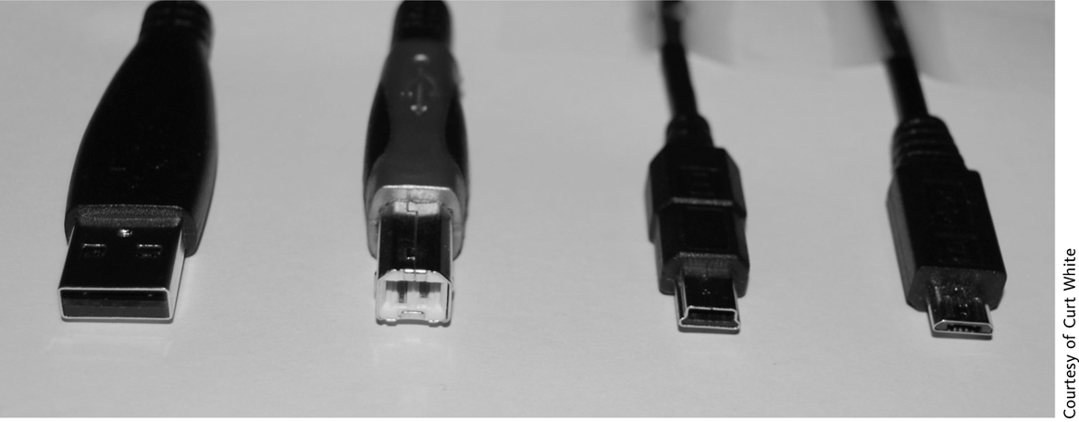
Universal Serial Bus (USB)
The USB interface is a modern standard for interconnecting a wide range of peripheral devices to computers
Supports plug and play
Can daisy-chain multiple devices
USB 2.0 can support 480 Mbps (USB 1.0 is only 12 Mbps)
USB 3.0 can support 4.8 Gbps
USB connectors, from left to right: Type A, Type B, Mini, Micro

Slide 12
Universal Serial Bus (USB)
The USB interface defines all four components
The electrical component defines two wires VBUS and Ground to carry a 5-volt signal, while the D+ and D- wires carry the data and signaling information
The mechanical component precisely defines the size of four different connectors and uses only four wires (the metal shell counts as one more connector)
The functional and procedural components are fairly complex but are based on the polled bus
The computer takes turns asking each peripheral if it has anything to send

Slide 13
FireWire
Low-cost digital interface
Capable of supporting transfer speeds of up to 800 Mbps
Hot pluggable
Supports two types of data connections:
Asynchronous connection
Isochronous connection

Slide 14
Thunderbolt
Digital interface currently found on Apple products
Capable of supporting transfer speeds of up to 10 Gbps
Uses same connector as existing Mini DisplayPort and similar protocol as PCI Express
Can daisy-chain devices and may get even faster with later versions

Slide 15
Lightning
Newer digital interface currently found on Apple products
Replaces the older 30-pin connector found on devices such as iPhones with a new 8-pin connector
Cannot be plugged in backwards

Slide 16
SCSI and iSCSI
SCSI (Small Computer System Interface)
A technique for interfacing a computer to high-speed devices such as hard disk drives, tape drives, CDs, and DVDs
Designed to support devices of a more permanent nature
SCSI is a systems interface
Need SCSI adapter
iSCSI (Internet SCSI)
A technique for interfacing disk storage to a computer via the Internet

Slide 17
InfiniBand and Fibre Channel
InfiniBand – a serial connection or bus that can carry multiple channels of data at the same time
Can support data transfer speeds of 2.5 billion bits (2.5 gigabits) per second and address thousands of devices, using both copper wire and fiber-optic cables
A network of high-speed links and switches
Fibre Channel – also a serial, high-speed network that connects a computer to multiple input/output devices
Supports data transfer rates up to billions of bits per second, but can support the interconnection of up to 126 devices only

Slide 18
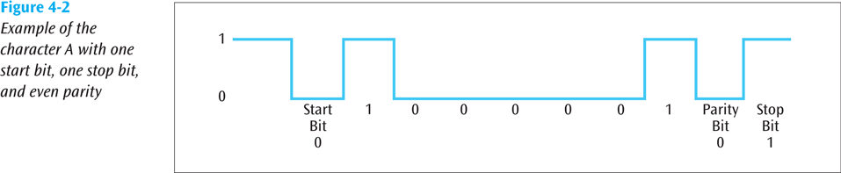
Asynchronous Connections
A type of connection defined at the data link layer
To transmit data from sender to receiver, an asynchronous connection creates a one-character package called a frame
Added to the front of the frame is a start bit, while a stop bit is added to the end of the frame
An optional parity bit can be added which can be used to detect errors
Source: Data Communications and Computer Networks: A Business User's Approach, Eighth Edition
© 2016. Cengage Learning. All right reserved.
Example of the character A with start bit, one stop bit, and even parity

Slide 19
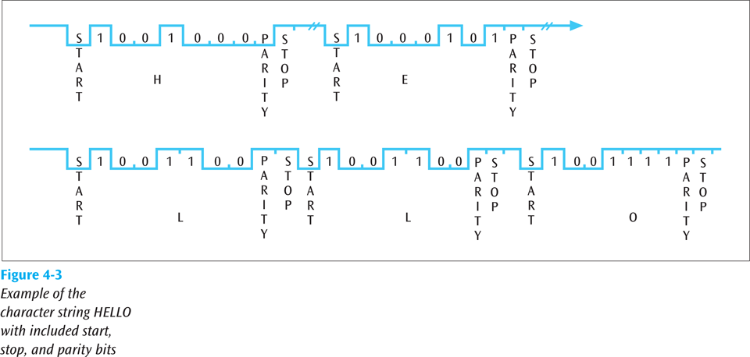
Asynchronous Connections
The term asynchronous is misleading here because you must always maintain synchronization between the incoming data stream and the receiver
Asynchronous connections maintain synchronization by using small frames with a leading start bit
Source: Data Communications and Computer Networks: A Business User's Approach, Eighth Edition
© 2016. Cengage Learning. All right reserved.
Example of the character string HELLO with included start, stop bit, and parity bits

Slide 20
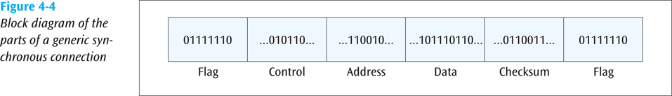
Synchronous Connections
A second type of connection defined at the data link layer
A synchronous connection creates a large frame that consists of header and trailer flags, control information, optional address information, error detection code, and data
A synchronous connection is more elaborate but transfers data in a more efficient manner
Source: Data Communications and Computer Networks: A Business User's Approach, Eighth Edition
© 2016. Cengage Learning. All right reserved.
Block diagram of the parts of a generic synchronous connection

Slide 21
Isochronous Connections
A third type of connection defined at the data link layer used to support real-time applications
Data must be delivered at just the right speed (real-time) – not too fast and not too slow
Typically an isochronous connection must allocate resources on both ends to maintain real-time
USB and Firewire can both support isochronous

Slide 22
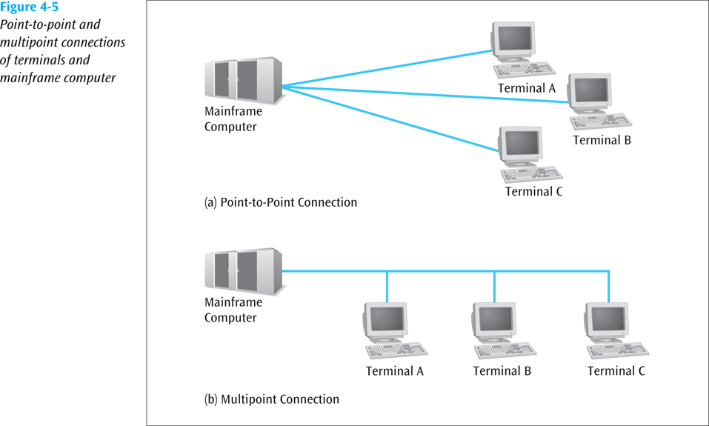
Terminal-to-Mainframe Computer Connections
Point-to-point connection – a direct, unshared connection between a terminal and a mainframe computer
Multipoint connection – a shared connection between multiple terminals and a mainframe computer
The mainframe is the primary and the terminals are the secondaries
Source: Data Communications and Computer Networks: A Business User's Approach, Eighth Edition
© 2016. Cengage Learning. All right reserved.
Point-to-point and multipoint connections of terminals and mainframe computer

Slide 23
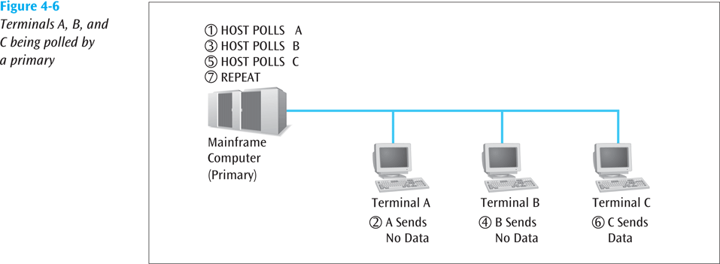
Terminal-to-Mainframe Computer Connections (cont..)
To allow a terminal to transmit data to a mainframe, the mainframe must poll the terminal
Two basic forms of polling: roll-call polling and hub polling
In roll-call polling, the mainframe polls each terminal in a round-robin fashion
In hub polling, the mainframe polls the first terminal, and this terminal passes the poll onto the next terminal
Source: Data Communications and Computer Networks: A Business User's Approach, Eighth Edition
© 2016. Cengage Learning. All right reserved.
Terminals A, B, and C being polled by a primary

Slide 24
Making Computer Connections In Action
A laptop computer has many different types of connectors, or connections
While every laptop can be different, if anyone has a laptop in class, maybe someone will volunteer to use theirs for show-and-tell
Power cord connection (why does the power cord have a big “brick” on it?)
USB connectors (one or more)
RJ-11 (telephone jack)
RJ-45 (LAN jack)
PC Card / SmartCard
DisplayPort (to connect your laptop to a video device)
Media card slot (SD, SDHC, xD, etc)
DB-15 (to connect to an external monitor or video projector)

Slide 25
Making Computer Connections In Action (continued)
A company wants to transfer files that are typically 700K chars in size
If an asynchronous connection is used, each character will have a start bit, a stop bit, and maybe a parity bit
700,000 chars * 11 bits/char (8 bits data + start + stop + parity) = 7,700,000 bits

Slide 26
Making Computer Connections In Action (continued)
If a synchronous connection is used, assume maximum payload size – 1500 bytes
To transfer a 700K char file requires 467 1500-character (byte) frames
Each frame will also contain 1-byte header, 1-byte address, 1-byte control, and 2-byte checksum, thus 5 bytes overhead
1500 bytes payload + 5 byte overhead = 1505 byte frames
467 frames * 1505 bytes/frame = 716,380 bytes, or 5,731,040 bits
Significantly less data using synchronous connection

Slide 27
Summary
Connection between a computer and a peripheral is often called the interface
Process of providing all the proper interconnections between a computer and a peripheral is called interfacing
The interface between computer and peripheral is composed of one to four components: electrical, mechanical, functional, and procedural
A DTE is a data terminating device
Computer
A DCE is a data circuit-terminating device
Modem

Slide 28
Summary (continued)
Two interface standards worthy of additional study: Universal Serial Bus, and EIA-232F
EIA-232F was one of the first highly popular standards
Universal Serial Bus is currently the most popular interface standard
Half-duplex systems can transmit data in both directions, but in only one direction at a time
Full-duplex systems can transmit data in both directions at the same time
Other peripheral interfacing standards that provide power, flexibility, and ease-of-installation include FireWire, Lightning, SCSI, iSCSI, InfiniBand, and Fibre Channel

Slide 29
Summary (continued)
While much of an interface standard resides at the physical layer, a data link connection is also required when data is transmitted between two points on a network
Three common data link connections include asynchronous connections, synchronous connections, and isochronous connections
Asynchronous connections use single-character frames and start and stop bits to establish the beginning and ending points of the frame
Synchronous connections use multiple-character frames, sometimes consisting of thousands of characters
Isochronous connections provide real-time connections between computers and peripherals and require a fairly involved dialog to support the connection

Slide 30
Summary (continued)
A point-to-point connection is one between a computer terminal and a mainframe computer that is dedicated to one terminal
A multipoint connection is a shared connection between more than one computer terminal and a mainframe computer

Slide 31

kent.edu.au Kent Institute Australia Pty. Ltd. ABN 49 003 577 302 ● CRICOS Code: 00161E ● RTO Code: 90458 ● TEQSA Provider Number: PRV12051

